Slide 1
Understanding Writing Patterns and Rhetoric

Slide 2
Goals for the Lesson
Introduction to three-part writing structure
How to read a prompt for pattern cues/keywords
Identifying the rhetorical situation of a writing prompt
Determining the pattern most appropriate for writing

Slide 3
Three-Part Structure Myths
The Five-Paragraph Form:
Introduction
hook: anecdote, sound, quote thesis: debatable claim and 3 points
II. Body Paragraphs
five sentences long
transitions: first, next, finally, in conclusion
III. Conclusion
summarize your essay/thesis

Slide 4
Definition
Purpose
Development
Organization

Slide 5
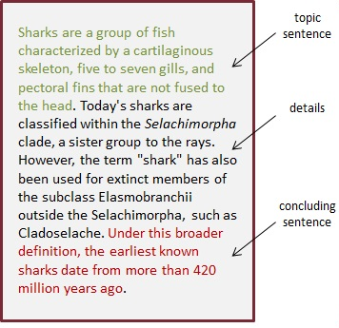
Three-Part Structure
Assertion
Evidence
Importance
Introduction
Body
Conclusion

Slide 6
So how do we know which pattern?
EXAMPLE: Analyze the long-term results of the Korean War on International Trade
Questions to ask yourself:
What is the goal(s) of answering the prompt?
What is my responsibility as a speaker?
What would a willing audience be looking for in my answer?
What expectations do the topic suggest for the theme and tone of my answer?

Slide 7
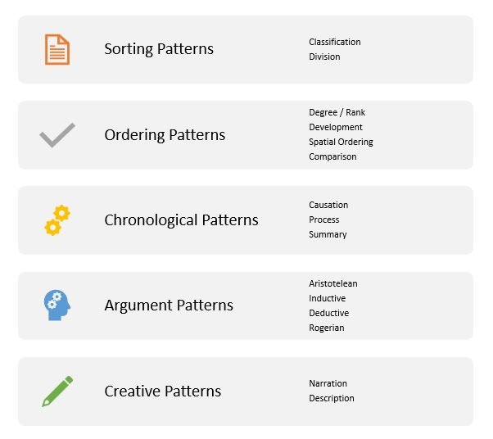
Each pattern has specific structures you can use to accomplish your purpose.

Slide 8
Let’s Practice (Zoom Class Only)
Watch the following video
Join your breakout room
Respond to the prompt about the video

Slide 9
Silence of the Lambs (3:45)

Slide 10
Potential Questions
What happened, in order, during the scene?
01
How and why does Clarice’s attitude change during the scene?
02
What protocol Has/Will the FBI follow To complete A psychobehavioral interview?
03

Slide 11
Rhetorical Situation
Intent of the Speaker
Needs of the Audience
Structure of the Message
Theme and Tone of the Topic
Understanding the Context

Slide 12
Elements of a Rhetorical Situation
Exigence
Method
Location
Expectations
Power
Research
Design
Events and feelings that compel the speaker
How the message is delivered (virtual, written, spoken)
What does the place of delivery make your audience feel
What does the audience expect from you, vice versa
Trust, fear, loyalty, fame, popularity, creativity, etc
What we tie our ideas to makes us credible
Color, images, shapes, and layout impact emotion
Genre
The style of writing employed and its specific conventions

Slide 13
Discuss the Rhetorical Situation

Slide 14
Practice on your own or with examples

